Slide 1
Well Come to Data Structure and Algorithm Analysis from Scratch
Theory + Practical
FAHAD HUSSAIN
MCS, MSCS, DAE(CIT)
Computer Science Instructor of well known international Center
Also, Machine Learning and Deep learning Practitioner
For further assistance, code and slide https://fahadhussaincs.blogspot.com/
YouTube Channel : https://www.youtube.com/fahadhussaintutorial

Slide 2
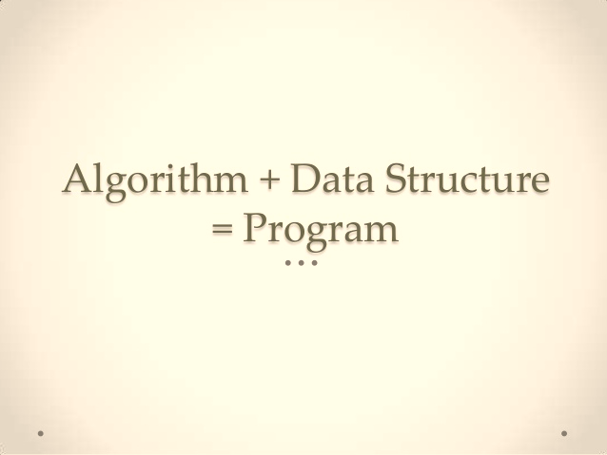
What is Data Structure & Algorithm and Pseudocode
Purpose of this course
Learn Data Structure and Algorithm
(Both way) Learn to Pass and Pass to get Job!
For further assistance, code and slide https://fahadhussaincs.blogspot.com/
YouTube Channal : https://www.youtube.com/fahadhussaintutorial

Slide 3
What is Data Structure & Algorithm and Pseudocode
A data structure is a particular way of organizing data in a computer so that it can be used effectively. For example, we can store a list of items having the same data-type using the array data structure.
The Algorithm is a finite sequence of well-defined, computer-implementable instructions, typically to solve a class of problems or to perform a computation. Algorithms are unambiguous specifications for performing calculation, data processing, automated reasoning, and other tasks.
Pseudocode (Fake Code) is an informal high-level description of the operating principle of a computer program or other algorithm
For further assistance, code and slide https://fahadhussaincs.blogspot.com/
YouTube Channel : https://www.youtube.com/fahadhussaintutorial

Slide 4
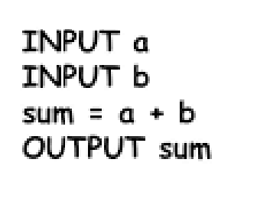
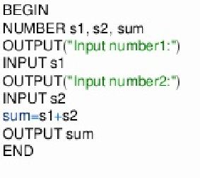
Algorithm and Pseudocode
#include <stdio.h>
int main()
{
int firstNumber, secondNumber, sumOfTwoNumbers;
printf("Enter two integers: ");
scanf("%d %d", &firstNumber, &secondNumber);
sumOfTwoNumbers = firstNumber + secondNumber;
printf("%d + %d = %d", firstNumber, secondNumber, sumOfTwoNumbers);
return 0;
}
Algorithm Pseudo Code Program(C lang)
For further assistance, code and slide https://fahadhussaincs.blogspot.com/
YouTube Channel : https://www.youtube.com/fahadhussaintutorial

Slide 5
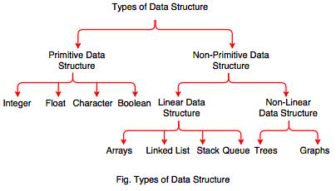
Data Structure Types
For further assistance, code and slide https://fahadhussaincs.blogspot.com/
YouTube Channel : https://www.youtube.com/fahadhussaintutorial

Slide 6
Data Structure Types
Primitive DS and non primitive DS
Linear DS and Non Linear DS
Static and Dynamic DS
Homogenous and Non Homogenous
For further assistance, code and slide https://fahadhussaincs.blogspot.com/
YouTube Channel : https://www.youtube.com/fahadhussaintutorial

Slide 7
Thank You!
For further assistance, code and slide https://fahadhussaincs.blogspot.com/
YouTube Channel : https://www.youtube.com/fahadhussaintutorial

Slide 8
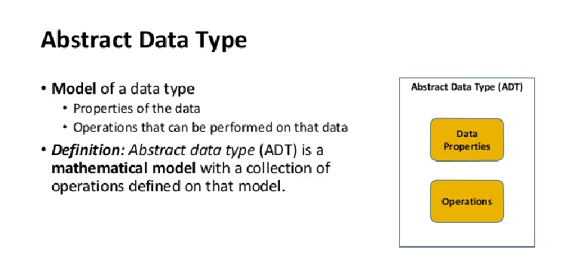
Data Structure Types
Data types | Abstract Data type
List
Stack
Queue
For further assistance, code and slide https://fahadhussaincs.blogspot.com/
YouTube Channel : https://www.youtube.com/fahadhussaintutorial

Slide 9
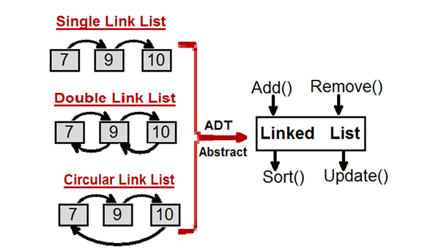
Example of Abstract Data Type
Abstract Data type (ADT) is a type (or class) for objects whose behavior is defined by a set of value and a set of operations. ... Think of ADT as a black box which hides the inner structure and design of the data type.
For further assistance, code and slide https://fahadhussaincs.blogspot.com/
YouTube Channel : https://www.youtube.com/fahadhussaintutorial

Slide 10
Thank You!
For further assistance, code and slide https://fahadhussaincs.blogspot.com/
YouTube Channel : https://www.youtube.com/fahadhussaintutorial

Slide 11

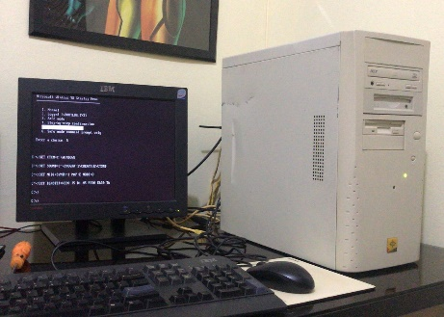
Algorithm Complexity
Efficiency of Algorithm
Space Complexity
Time Complexity
Experimental Study to Find?
It must be Hardware and software independent
For further assistance, code and slide https://fahadhussaincs.blogspot.com/
YouTube Channel : https://www.youtube.com/fahadhussaintutorial

Slide 12
Reason!
Why we analysis the algo. because we find the performance, and compare with others
We cannot find the complexity of the program because it is depend on OS, machine and compiler/interpreter
Therefore we need the separate step which is independent from any specific program and machine
For further assistance, code and slide https://fahadhussaincs.blogspot.com/
YouTube Channel : https://www.youtube.com/fahadhussaintutorial

Slide 13
Space Complexity Concept
For any algorithm memory may be used for the following
Variables (This include the constant values, temporary values)
Program Instruction
Execution
Space complexity is the amount of memory used by the algorithm (including the input values to the algorithm) to execute and produce the result.
Sometime Auxiliary Space is confused with Space Complexity. But Auxiliary Space is the extra space or the temporary space used by the algorithm during it's execution.
Space Complexity = Auxiliary Space + Input space
For further assistance, code and slide https://fahadhussaincs.blogspot.com/
YouTube Channel : https://www.youtube.com/fahadhussaintutorial

Slide 14
Space Complexity
The amount of memory required by an algo. to turn to completion!
The term memory leaks refer to the amount of memory required is larger than the memory available on given by system.
Fixed Part: int , float, double
Variable Part: (not sure about the size of problem) like dynamic array a[];
formula: S(p) = C + S(instance characteristics)
For further assistance, code and slide https://fahadhussaincs.blogspot.com/
YouTube Channel : https://www.youtube.com/fahadhussaintutorial

Slide 15
Space Complexity examples
formula: S(p) = C + S(instance characteristics)
int sum(int x, int y, int z)
{
int r = x + y + z;
return r;
}
For further assistance, code and slide https://fahadhussaincs.blogspot.com/
YouTube Channel : https://www.youtube.com/fahadhussaintutorial

Slide 16
Space Complexity examples
formula: S(p) = C + S(instance characteristics)
int sum(int a[], int n)
{
int x = 0; // 4 bytes for x
for(int i = 0; i < n; i++) // 4 bytes for i
{
x = x + a[i];
}
return(x);
}
For further assistance, code and slide https://fahadhussaincs.blogspot.com/
YouTube Channel : https://www.youtube.com/fahadhussaintutorial

Slide 17
Space Complexity examples
formula: S(p) = C + S(instance characteristics)
int sum(int a[], int n) {
int r = 0;
for (int i = 0; i < n; ++i) {
r += a[i];
}
return r;
}
For further assistance, code and slide https://fahadhussaincs.blogspot.com/
YouTube Channel : https://www.youtube.com/fahadhussaintutorial

Slide 18
Time Complexity
RAM Model (Random access machine)
RAM( Random access machine):
Measure the run time of an algorithm by counting the number of steps
An idealized notion of how the compute works
Each simple operation (-,+,*,=,if) takes exactly 1 step
Each memory access takes exactly 1 step
Loop and method calls are not simple option, but depends upon the size of the data and the contents of the method.
For further assistance, code and slide https://fahadhussaincs.blogspot.com/
YouTube Channel : https://www.youtube.com/fahadhussaintutorial

Slide 19
Time Complexity
Cases
Best
Average
Worst
For further assistance, code and slide https://fahadhussaincs.blogspot.com/
YouTube Channel : https://www.youtube.com/fahadhussaintutorial

Slide 20
Time Complexity, Example
Int numbers = array(14,82,4,0,24,28);
foreach(numbers as number)
{
print $number;
}
time complexity as O(n)
For further assistance, code and slide https://fahadhussaincs.blogspot.com/
YouTube Channel : https://www.youtube.com/fahadhussaintutorial

Slide 21
Time Complexity, Example
$numbers = array(14,82,4,0,24,28);
foreach(numbers as number1)
{
foreach(numbers as number2)
{
if(number1 >= number2)
{
print number1 . " is greater than or equal to " . number2;
}
else
{
print number1 . " is smaller than " . number2;
}
}
}
time complexity as O(n²)
For further assistance, code and slide https://fahadhussaincs.blogspot.com/
YouTube Channel : https://www.youtube.com/fahadhussaintutorial

Slide 22
Asymptotic Notations, Time Complexity
Asymptotic Notations are languages that allow us to analyze an algorithm's running time by identifying its behavior as the input size for the algorithm increases. This is also known as an algorithm's growth rate.
When we compare the 2 algo.
Three types of Asymptotic Notations
Big O (Asymptotic Upper bound (Worst case), shows work on using max. time)
f(n) <= g(n)
Omega (Asymptotic Lower bound (Best case), shows work on using min. time)
f(n) >= g(n)
Theta (Asymptotic tight bound (Best case), shows work on using avg. time
f(n) = g(n)
For further assistance, code and slide https://fahadhussaincs.blogspot.com/
YouTube Channel : https://www.youtube.com/fahadhussaintutorial

Slide 23
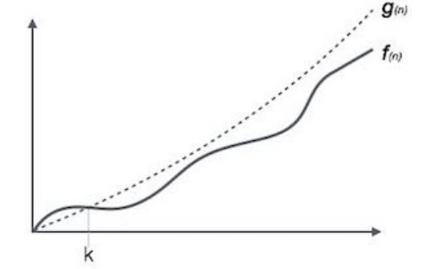
Asymptotic Notations, Time Complexity
The notation Ο(n) is the formal way to express the upper bound of an algorithm's running time. It measures the worst case time complexity or the longest amount of time an algorithm can possibly take to complete.
Ο(f(n)) = { g(n) : there exists c > 0 and n0 such that f(n) ≤ c.g(n) for all n > n0. }
For further assistance, code and slide https://fahadhussaincs.blogspot.com/
YouTube Channel : https://www.youtube.com/fahadhussaintutorial

Slide 24
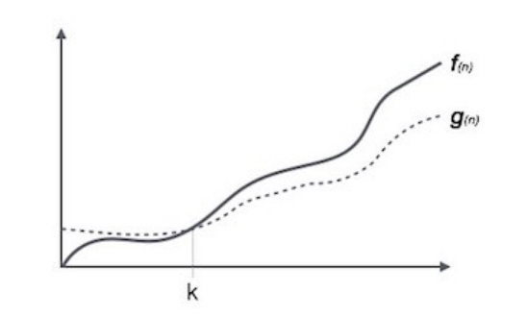
Asymptotic Notations, Time Complexity
The notation Ω(n) is the formal way to express the lower bound of an algorithm's running time. It measures the best case time complexity or the best amount of time an algorithm can possibly take to complete.
Ω(f(n)) ≥ { g(n) : there exists c > 0 and n0 such that g(n) ≤ c.f(n) for all n > n0. }
For further assistance, code and slide https://fahadhussaincs.blogspot.com/
YouTube Channel : https://www.youtube.com/fahadhussaintutorial

Slide 25
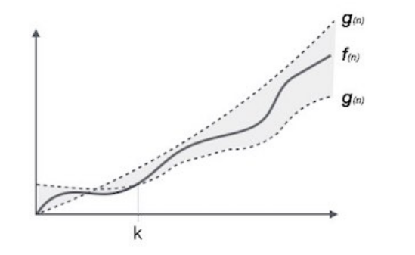
Asymptotic Notations, Time Complexity
The notation θ(n) is the formal way to express both the lower bound and the upper bound of an algorithm's running time.
θ(f(n)) = { g(n) if and only if g(n) = Ο(f(n)) and g(n) = Ω(f(n)) for all n > n0. }
For further assistance, code and slide https://fahadhussaincs.blogspot.com/
YouTube Channel : https://www.youtube.com/fahadhussaintutorial

Slide 26
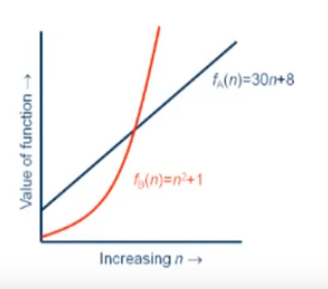
Asymptotic Notations, Time Complexity
Algorithm's growth rate
F (n) = 3n + 2n +100
For further assistance, code and slide https://fahadhussaincs.blogspot.com/
YouTube Channel : https://www.youtube.com/fahadhussaintutorial

Slide 27
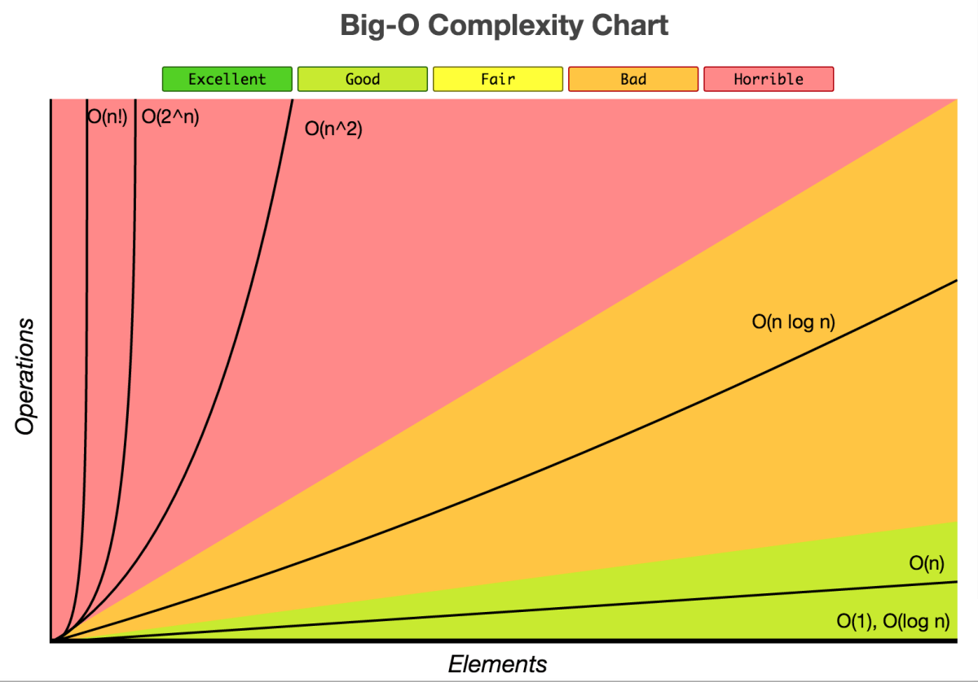
Asymptotic Notations, Time Complexity
For further assistance, code and slide https://fahadhussaincs.blogspot.com/
YouTube Channel : https://www.youtube.com/fahadhussaintutorial

Slide 28
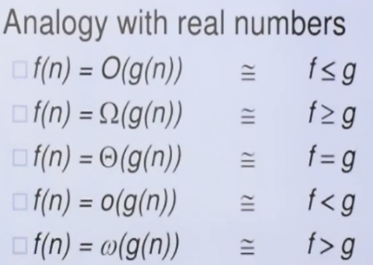
Asymptotic Notations, Time Complexity
For further assistance, code and slide https://fahadhussaincs.blogspot.com/
YouTube Channel : https://www.youtube.com/fahadhussaintutorial

Slide 29
Asymptotic Notations, Time Complexity
For further assistance, code and slide https://fahadhussaincs.blogspot.com/
YouTube Channel : https://www.youtube.com/fahadhussaintutorial

Slide 30
Thank You!
For further assistance, code and slide https://fahadhussaincs.blogspot.com/
YouTube Channel : https://www.youtube.com/fahadhussaintutorial

Slide 31
Data Structure Types
For further assistance, code and slide https://fahadhussaincs.blogspot.com/
YouTube Channel : https://www.youtube.com/fahadhussaintutorial

Slide 32
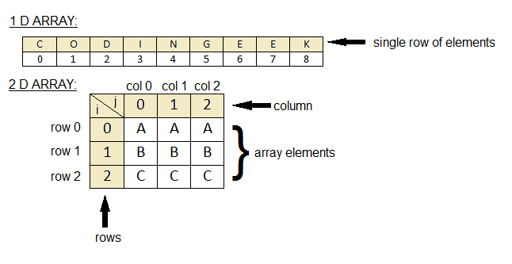
Array Data Structure
Linear Data Structure which is a collection of data items having similar data types (homogenous) stored in contiguous memory location. By knowing the address of the first item we can easily access all items/elements of an array.
For further assistance, code and slide https://fahadhussaincs.blogspot.com/
YouTube Channel : https://www.youtube.com/fahadhussaintutorial

Slide 33
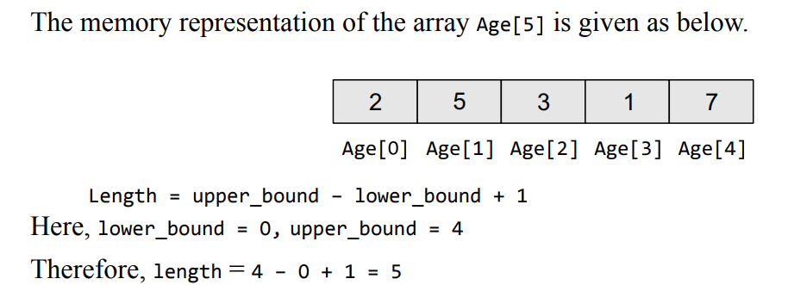
Array Data Structure (Length)
Length = upper_bound – lower_bound + 1
For further assistance, code and slide https://fahadhussaincs.blogspot.com/
YouTube Channel : https://www.youtube.com/fahadhussaintutorial

Slide 34
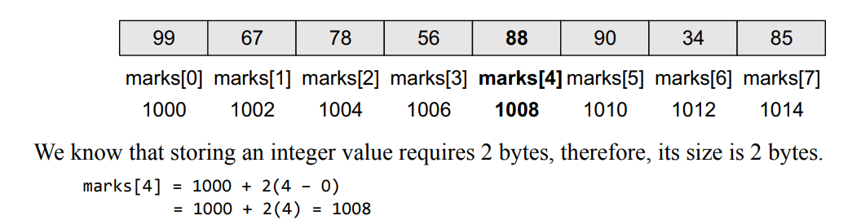
Array calculate the address
For further assistance, code and slide https://fahadhussaincs.blogspot.com/
YouTube Channel : https://www.youtube.com/fahadhussaintutorial

Slide 35
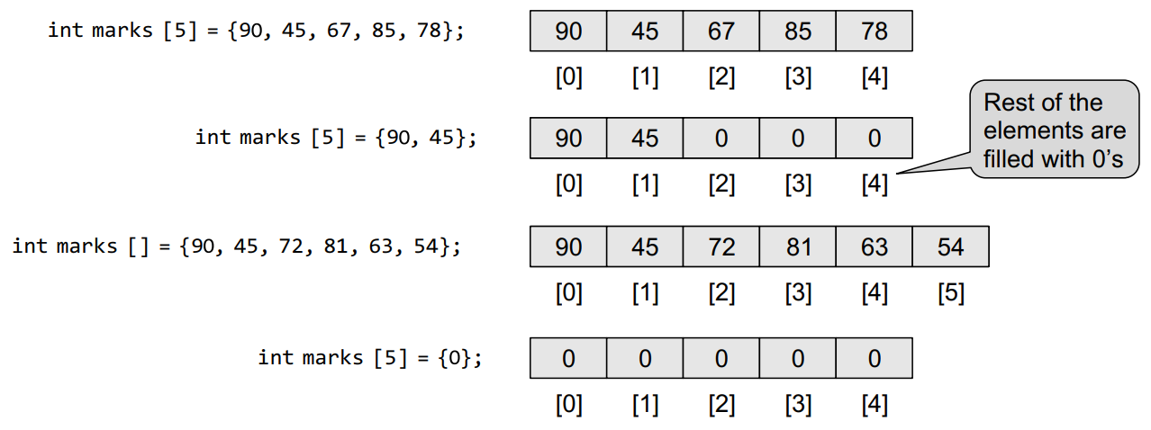
Array Data Structure
For further assistance, code and slide https://fahadhussaincs.blogspot.com/
YouTube Channel : https://www.youtube.com/fahadhussaintutorial

Slide 36
Array Data Structure
There are a number of operations that can be preformed on arrays.
Traversing an array
Inserting an element in an array
Searching an element in an array
Deleting an element from an array
Merging two arrays
Sorting an array in ascending or descending order
For further assistance, code and slide https://fahadhussaincs.blogspot.com/
YouTube Channel : https://www.youtube.com/fahadhussaintutorial

Slide 37
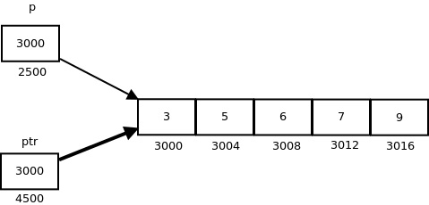
Array (address) and (Pointer)
Pointer is the reference of the value of other variable.
For further assistance, code and slide https://fahadhussaincs.blogspot.com/
YouTube Channel : https://www.youtube.com/fahadhussaintutorial

Slide 38
Array Usage
Arrays are widely used to implement mathematical vectors, matrices, and other kinds of rectangular tables.
Many databases include one-dimensional arrays whose elements are records.
Arrays are also used to implement other data structures such as strings, stacks, queues, heaps, and hash tables. We will read about these data structures in the subsequent chapters.
Arrays can be used for sorting elements in ascending or descending order
For further assistance, code and slide https://fahadhussaincs.blogspot.com/
YouTube Channel : https://www.youtube.com/fahadhussaintutorial

Slide 39
Array
Advantages
Multiple data items of same data type can be accessed using single name
Arrays can be used to implement matrices
Data structure like queue , linked list can be accessed using arrays
Disadvantages
We must know in advance that how many elements are to be stored in an array
Array is static structure. It means that array is of fixed size. The memory which is allocated to array can not be increased or reduced.
Insertion and deletion are quite difficult in array. As the elements are stored in consecutive memory locations.
For further assistance, code and slide https://fahadhussaincs.blogspot.com/
YouTube Channel : https://www.youtube.com/fahadhussaintutorial

Slide 40
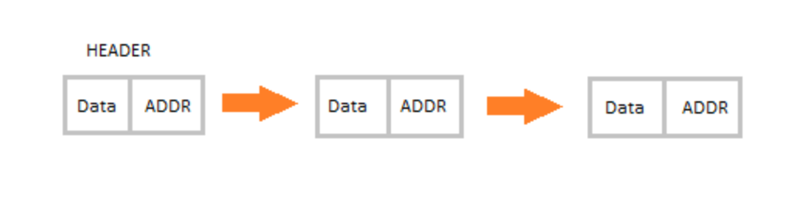
Link List DS
A linked list is a linear data structure, in which the elements are not stored at contiguous memory locations. The elements in a linked list are linked using pointers.
In simple words, a linked list consists of nodes where each node contains a data field and a reference(link) to the next node in the list.

Slide 41
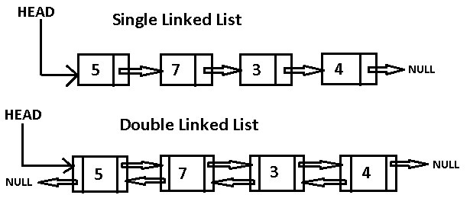
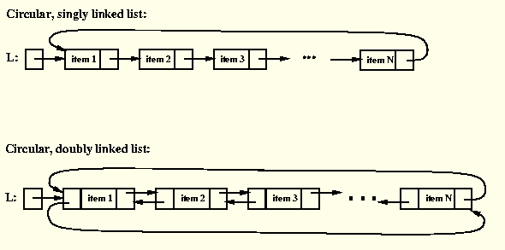
Link List DS (types)

Slide 42
Link List DS Operation
Create – Create the link list
Insertion − Adds an element at the beginning of the list.
Deletion − Deletes an element at the beginning of the list.
Display − Displays the complete list.
Search − Searches an element using the given key.
For further assistance, code and slide https://fahadhussaincs.blogspot.com/
YouTube Channel : https://www.youtube.com/fahadhussaintutorial

Slide 43
Link List DS Operation
Create – Create the link list
struct Node
{
int data;
struct Node* next;
};
For further assistance, code and slide https://fahadhussaincs.blogspot.com/
YouTube Channel : https://www.youtube.com/fahadhussaintutorial

Slide 44
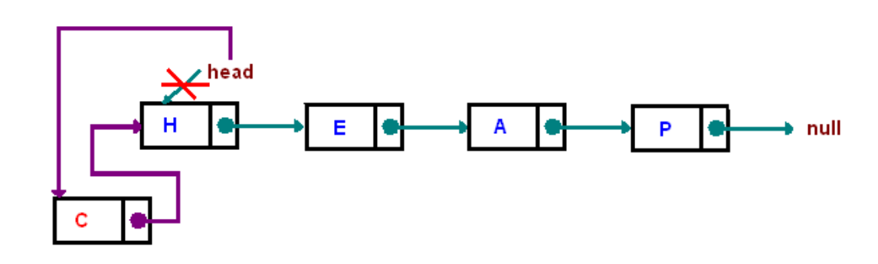
Link List DS Operation
Insertion
For further assistance, code and slide https://fahadhussaincs.blogspot.com/
YouTube Channel : https://www.youtube.com/fahadhussaintutorial

Slide 45
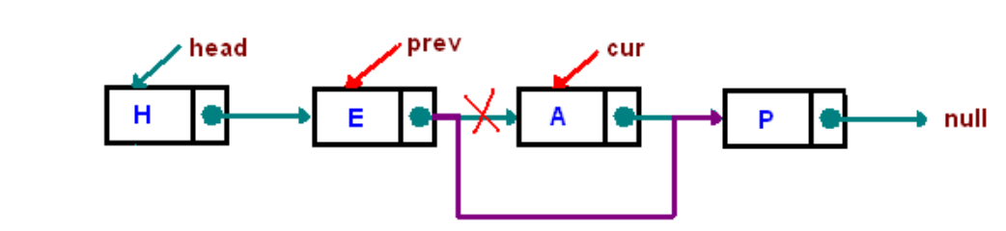
Link List DS Operation
Deletion
For further assistance, code and slide https://fahadhussaincs.blogspot.com/
YouTube Channel : https://www.youtube.com/fahadhussaintutorial

Slide 46
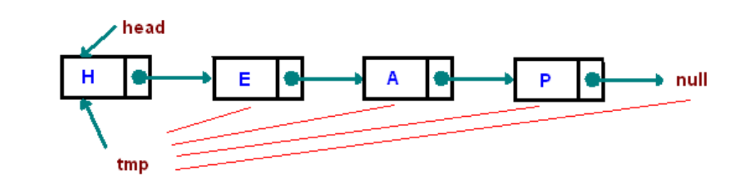
Link List DS Operation
Display
Define a node current which initially points to the head of the list.
Traverse through the list till current points to null.
Display each node by making current to point to node next to it in each iteration.
For further assistance, code and slide https://fahadhussaincs.blogspot.com/
YouTube Channel : https://www.youtube.com/fahadhussaintutorial

Slide 47
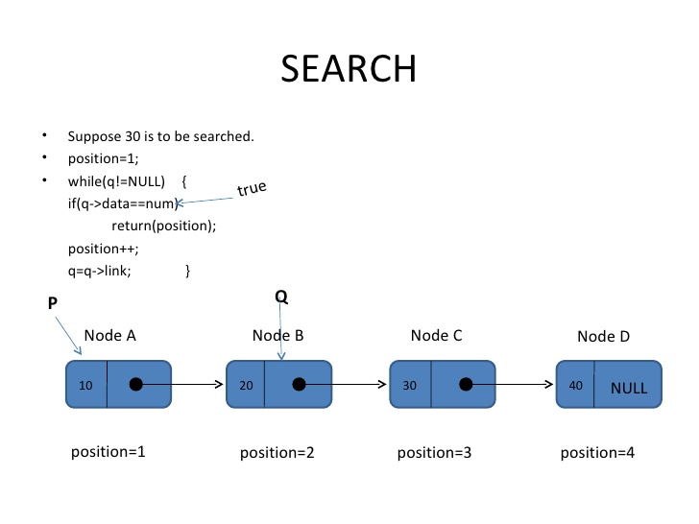
Link List DS Operation
Search
For further assistance, code and slide https://fahadhussaincs.blogspot.com/
YouTube Channel : https://www.youtube.com/fahadhussaintutorial

Slide 48
Link List DS Operation (Practical)
Remaining….
For further assistance, code and slide https://fahadhussaincs.blogspot.com/
YouTube Channel : https://www.youtube.com/fahadhussaintutorial

Slide 49
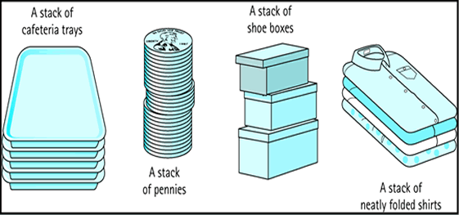
Stack Data Structure
Stack is a container of objects that are inserted and removed according to the last-in first-out (LIFO) principle (Abstract Data type).
Stack can be created by using Array and link list
A stack is a recursive data structure. Here is a structural definition of a Stack: a stack is either empty or it consists of a top and the rest which is a stack;
For further assistance, code and slide https://fahadhussaincs.blogspot.com/
YouTube Channel : https://www.youtube.com/fahadhussaintutorial

Slide 50
Stack Data Structure
Create a stack
Insert an element (PUSH)
Delete an element (POP)
Peek (Checking the top element)
Traversing (Printing the all elements)
isEmpty (check the stack is empty)
Size
For further assistance, code and slide https://fahadhussaincs.blogspot.com/
YouTube Channel : https://www.youtube.com/fahadhussaintutorial

Slide 51
Application of Stack Data Structure
The simplest application of a stack is to reverse a word. You push a given word to stack - letter by letter - and then pop letters from the stack.
Another application is an "undo" mechanism in text editors; this operation is accomplished by keeping all text changes in a stack.
Infix/Postfix Prefix conversation
For further assistance, code and slide https://fahadhussaincs.blogspot.com/
YouTube Channel : https://www.youtube.com/fahadhussaintutorial

Slide 52
Application of Stack Data Structure Infix/Postfix Prefix conversation (Equation Parsing) Types of Notation
Infix Notation c= a + b
Prefix Notation (Polish notation) c = +ab
Postfix Notation (Reverse Polish Notation) c = ab+
Operator Precedence
Exponent , Division and Multiply , Add/Subts
For further assistance, code and slide https://fahadhussaincs.blogspot.com/
YouTube Channel : https://www.youtube.com/fahadhussaintutorial

Slide 53
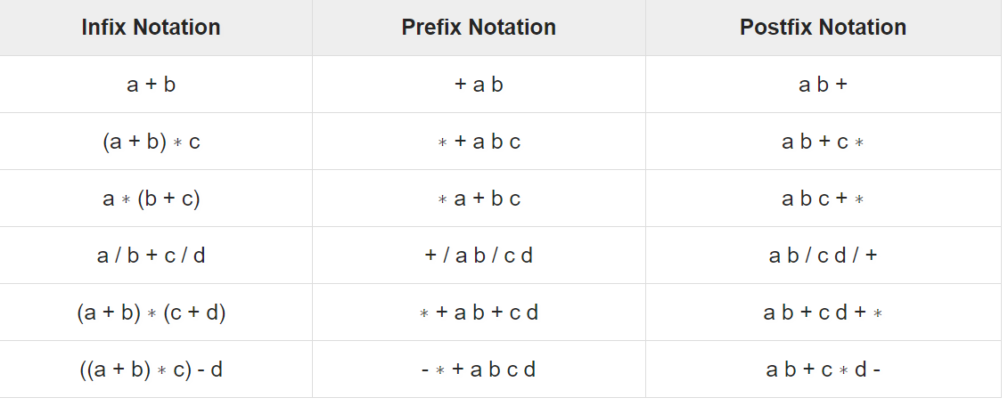
Application of Stack Data Structure More Clearly
For further assistance, code and slide https://fahadhussaincs.blogspot.com/
YouTube Channel : https://www.youtube.com/fahadhussaintutorial

Slide 54
Application of Stack Data Structure (Prefix)
1. Push left parenthesis onto STACK and add right parenthesis at the end of Q.
2. Scan Q from left to right and repeat step 3 to 6 for each element of Q until the STACK is empty.
3. If an operand is encountered add it to P.
4. If a left parenthesis is encountered push it onto the STACK.
5. If an operator is encountered, then Repeatedly pop from STACK and add to P each operator which has same precedence as or higher precedence than the operator encountered. Push the encountered operator onto the STACK.
6. If a right parenthesis is encountered, then Repeatedly pop from the STACK and add to P each operator until a left parenthesis is encountered. Remove the left parenthesis; do not add it to P.
7. Exit
For further assistance, code and slide https://fahadhussaincs.blogspot.com/
YouTube Channel : https://www.youtube.com/fahadhussaintutorial

Slide 55
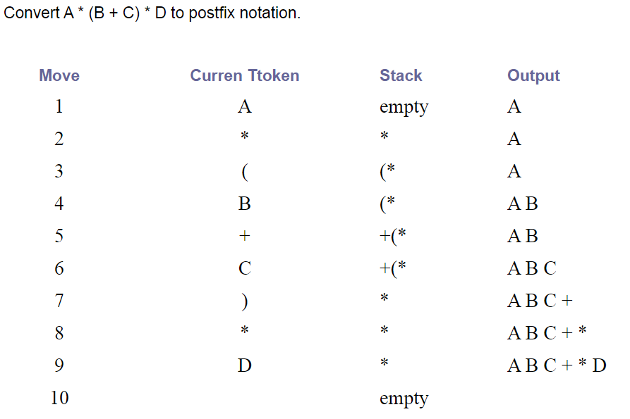
Application of Stack Data Structure (Postfix conversation)
For further assistance, code and slide https://fahadhussaincs.blogspot.com/
YouTube Channel : https://www.youtube.com/fahadhussaintutorial

Slide 56
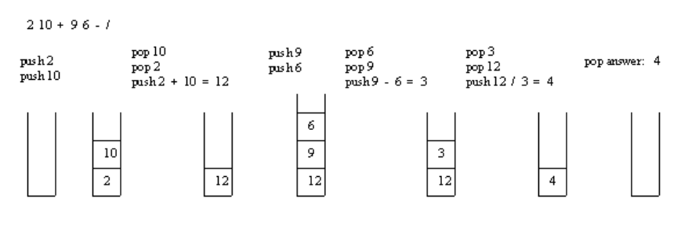
Application of Stack Data Structure (Postfix evaluation)
Add the ) at the end of equation
If the element is an operand, push it into the stack.
If the element is an operator O, pop twice and get A and B respectively. Calculate BOA and push it back to the stack.
When the expression is ended, the value in the stack is the final answer.
For further assistance, code and slide https://fahadhussaincs.blogspot.com/
YouTube Channel : https://www.youtube.com/fahadhussaintutorial

Slide 57
Application of Stack Data Structure (Tower of Hanoi)
Tower of Hanoi is a mathematical puzzle where we have three rods and n disks. The objective of the puzzle is to move the entire stack to another rod, obeying the following simple rules:
1) Only one disk can be moved at a time. 2) Each move consists of taking the upper disk from one of the stacks and placing it on top of another stack i.e. a disk can only be moved if it is the uppermost disk on a stack. 3) No disk may be placed on top of a smaller disk.
For further assistance, code and slide https://fahadhussaincs.blogspot.com/
YouTube Channel : https://www.youtube.com/fahadhussaintutorial

Slide 58
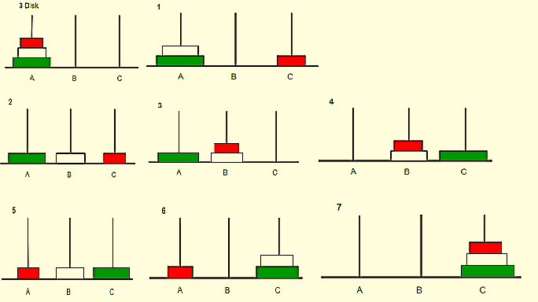
Application of Stack Data Structure (Tower of Hanoi)
For further assistance, code and slide https://fahadhussaincs.blogspot.com/
YouTube Channel : https://www.youtube.com/fahadhussaintutorial

Slide 59
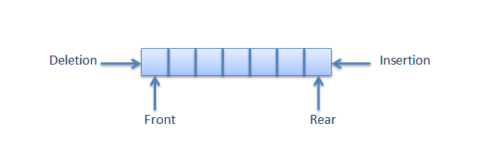
Queue Data Structure
A queue is a container of objects (a linear collection) that are inserted and removed according to the first-in first-out (FIFO) principle (Abstract Data type).
Queue can be created by using Array and link list
The difference between stacks and queues is in removing. In a stack we remove the item the most recently added; in a queue, we remove the item the least recently added.
For further assistance, code and slide https://fahadhussaincs.blogspot.com/
YouTube Channel : https://www.youtube.com/fahadhussaintutorial

Slide 60
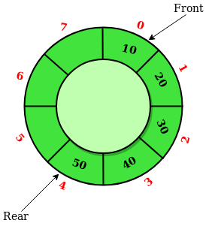
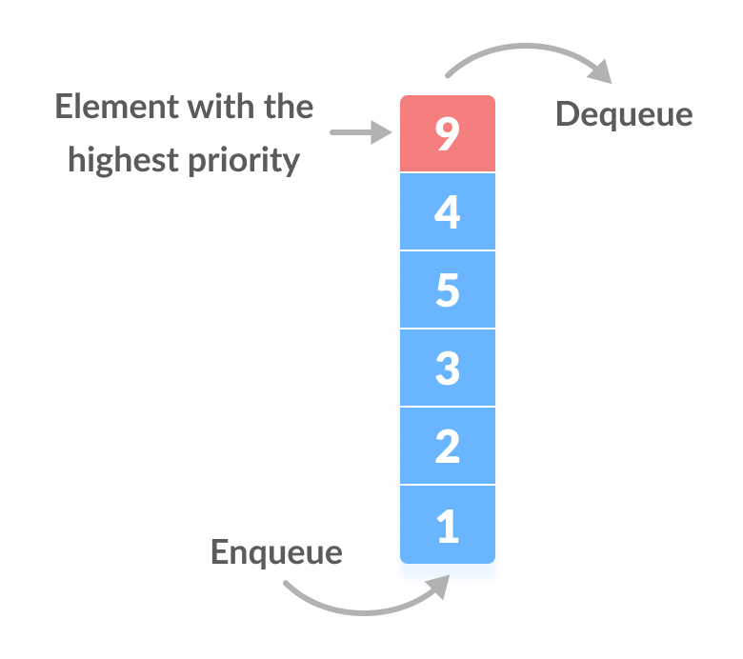
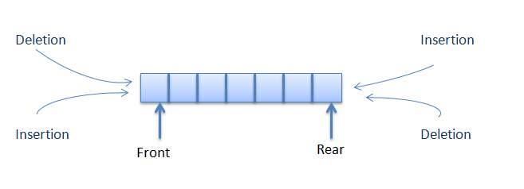
Types of Queue Data Structure
Simple Queue
Circular Queue
Priority Queue
Doubly Ended Queue
Input Restricted Deque
Output Restricted Deque
For further assistance, code and slide https://fahadhussaincs.blogspot.com/
YouTube Channel : https://www.youtube.com/fahadhussaintutorial

Slide 61
Operation of Queue Data Structure
Create a Queue
Insert a element in a Queue (Enqueue)
Delete a element in a Queue (Dequeue)
Traversing elements
Enqueue means to insert an item into the back of the queue, dequeue means removing the front item
For further assistance, code and slide https://fahadhussaincs.blogspot.com/
YouTube Channel : https://www.youtube.com/fahadhussaintutorial

Slide 63
Thank You!
For further assistance, code and slide https://fahadhussaincs.blogspot.com/
YouTube Channel : https://www.youtube.com/fahadhussaintutorial

Slide 64
Recursion
The process in which a function calls itself directly or indirectly is called recursion and the corresponding function is called as recursive function. Using recursive algorithm, certain problems can be solved quite easily.
Examples of such problems are,
Towers of Hanoi (TOH),
Inorder /Preorder/ Postorder Tree Traversals,
DFS of Graph, etc.
For further assistance, code and slide https://fahadhussaincs.blogspot.com/
YouTube Channel : https://www.youtube.com/fahadhussaintutorial

Slide 65
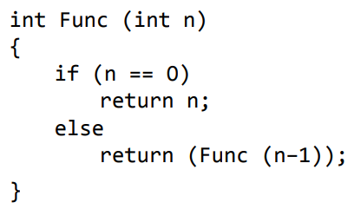
Recursion
Direct Recursion
A function is said to be directly recursive if it explicitly calls itself.
For further assistance, code and slide https://fahadhussaincs.blogspot.com/
YouTube Channel : https://www.youtube.com/fahadhussaintutorial

Slide 66
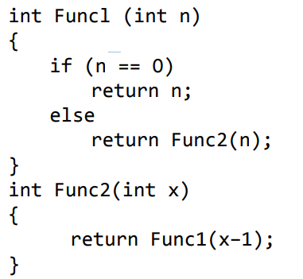
Recursion
Indirect Recursion
A function is said to be indirectly recursive if it contains a call to another function which ultimately calls it.
For further assistance, code and slide https://fahadhussaincs.blogspot.com/
YouTube Channel : https://www.youtube.com/fahadhussaintutorial

Slide 67
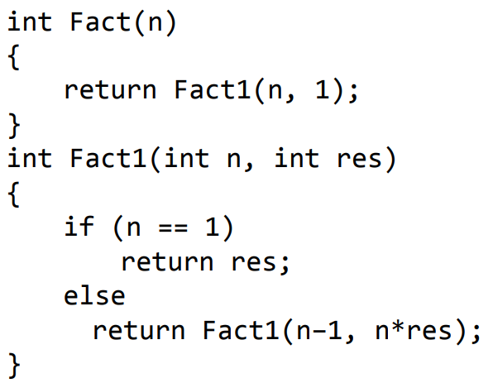
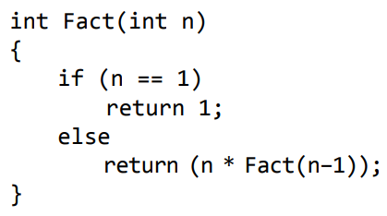
Recursion
Tail Recursion
A recursive function is said to be tail recursive if no operations are pending to be performed when the recursive function returns to its caller. when the called function returns, the returned value is immediately returned from the calling function. Tail recursive functions are highly desirable because they are much more efficient to use as the amount of information that has to be stored on the system stack is independent of the number of recursive calls.
Non-Tail Recursion
Tail Recursion
For further assistance, code and slide https://fahadhussaincs.blogspot.com/
YouTube Channel : https://www.youtube.com/fahadhussaintutorial

Slide 68
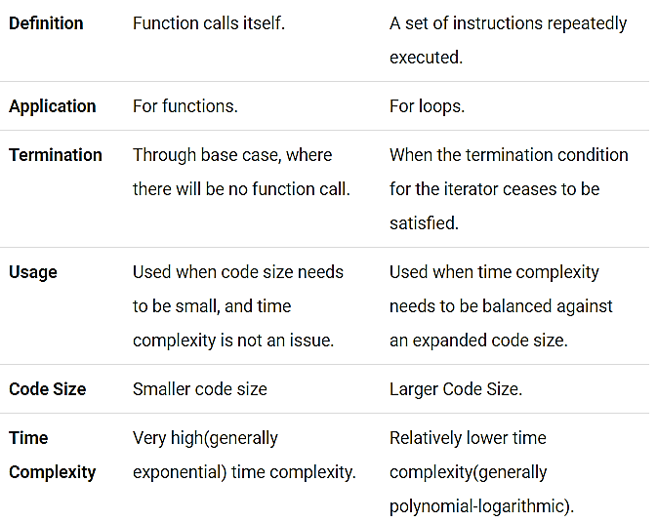
Recursion vs Iteration
Iteration can include repetition of a sequence of operations in order to get ever closer to a desired result.
For further assistance, code and slide https://fahadhussaincs.blogspot.com/
YouTube Channel : https://www.youtube.com/fahadhussaintutorial

Slide 69
Thank You!
For further assistance, code and slide https://fahadhussaincs.blogspot.com/
YouTube Channel : https://www.youtube.com/fahadhussaintutorial

Slide 70
Searching Techniques in Data Structure
Searching is the process of finding a given value position in a list of values. It decides whether a search key is present in the data or not. It is the algorithmic process of finding a particular item in a collection of items. It can be done on internal data structure or on external data structure.
1. Sequential Search (Linear Search) 2. Binary Search
3. Jump Search
For further assistance, code and slide https://fahadhussaincs.blogspot.com/
YouTube Channel : https://www.youtube.com/fahadhussaintutorial

Slide 71
Searching Techniques in Data Structure Algorithm
Array or link list must be sorted first, then,
Step 1: Select the first element as the current element.
Step 2: Compare the current element with the target element. If matches, then go to step 5.
Step 3: If there is a next element, then set current element to next element and go to Step 2.
Step 4: Target element not found. Go to Step 6.
Step 5: Target element found and return location.
Step 6: Exit process.
For further assistance, code and slide https://fahadhussaincs.blogspot.com/
YouTube Channel : https://www.youtube.com/fahadhussaintutorial

Slide 72
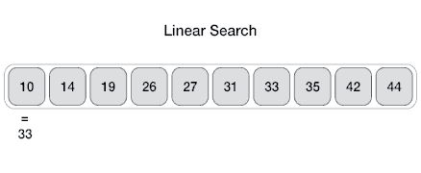
Searching Techniques in Data Structure
Linear search is the simplest search algorithm and often called sequential search. In this type of searching, we simply traverse the list completely and match each element of the list with the item whose location is to be found. If the match found then location of the item is returned otherwise the algorithm return NULL.
For further assistance, code and slide https://fahadhussaincs.blogspot.com/
YouTube Channel : https://www.youtube.com/fahadhussaintutorial

Slide 73
Searching Techniques in Data Structure
Complexity
Worst case time complexity: O(N)
Average case time complexity: O(N)
Best case time complexity: O(1)
Space complexity: O(1)
Lets come to code….
For further assistance, code and slide https://fahadhussaincs.blogspot.com/
YouTube Channel : https://www.youtube.com/fahadhussaintutorial

Slide 74
Searching Techniques in Data Structure
int linear_Search (int values[], int target, int n)
{
for(int i = 0; i < n; i++)
{
if (values[i] == target)
{
return i;
}
}
return -1;
}
For further assistance, code and slide https://fahadhussaincs.blogspot.com/
YouTube Channel : https://www.youtube.com/fahadhussaintutorial

Slide 75
Thank You!
For further assistance, code and slide https://fahadhussaincs.blogspot.com/
YouTube Channel : https://www.youtube.com/fahadhussaintutorial

Slide 76
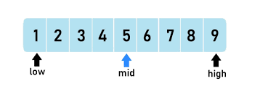
Binary Search
Binary search follows divide and conquer approach in which, the list is divided into two halves and the item is compared with the middle element of the list. If the match is found then, the location of middle element is returned otherwise, we search into either of the halves depending upon the result produced through the match.
For further assistance, code and slide https://fahadhussaincs.blogspot.com/
YouTube Channel : https://www.youtube.com/fahadhussaintutorial

Slide 77
Binary Search Algorithm
Start with the middle element
If the target value is equal to the middle element of the array, then return the index of the middle element.
If not, then compare the middle element with the target value,
If the target value is greater than the number in the middle index, then pick the elements to the right of the middle index, and start with Step 1.
If the target value is less than the number in the middle index, then pick the elements to the left of the middle index, and start with Step 1.
When a match is found, return the index of the element matched.
If no match is found, then return -1
For further assistance, code and slide https://fahadhussaincs.blogspot.com/
YouTube Channel : https://www.youtube.com/fahadhussaintutorial

Slide 78
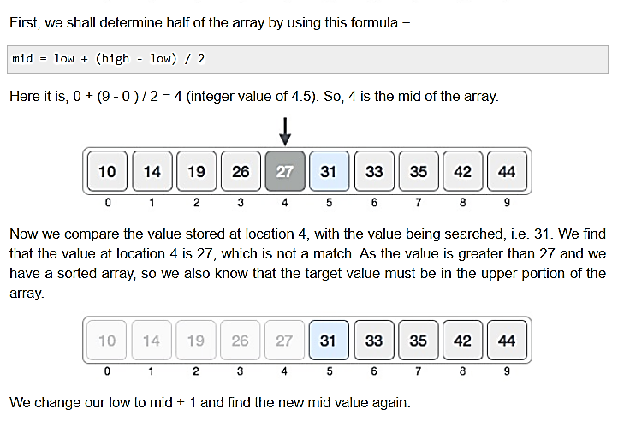
Binary Search Algorithm
For further assistance, code and slide https://fahadhussaincs.blogspot.com/
YouTube Channel : https://www.youtube.com/fahadhussaintutorial

Slide 79
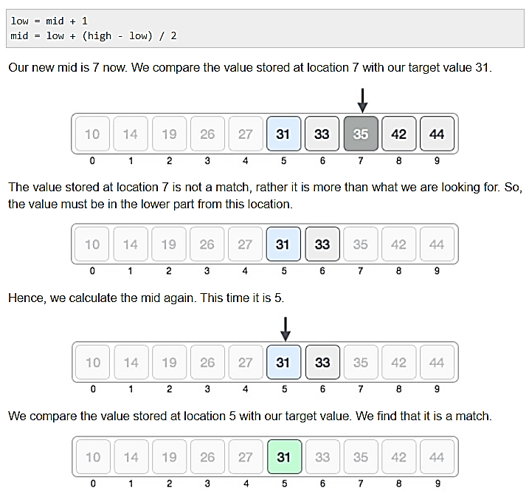
Binary Search Algorithm
We conclude that the target value 31 is stored at location 5.
Binary search halves the searchable items and thus reduces the count of comparisons to be made to very less numbers.
For further assistance, code and slide https://fahadhussaincs.blogspot.com/
YouTube Channel : https://www.youtube.com/fahadhussaintutorial

Slide 80
Binary Search Algorithm Code
int binarySearch(int values[], int len, int target)
{
int max = (len - 1);
int min = 0;
int guess; // this will hold the index of middle elements
int step = 0; // to find out in how many steps we completed the search
while(max >= min)
{
guess = (max + min) / 2;
step++;
if(values[guess] == target)
{
printf("Number of steps required for search: %d \n", step);
return guess;
}
else if(values[guess] > target)
{
max = (guess - 1);
}
else
{
min = (guess + 1);
}
}
return -1;
}
For further assistance, code and slide https://fahadhussaincs.blogspot.com/
YouTube Channel : https://www.youtube.com/fahadhussaintutorial

Slide 81
Binary Search Algorithm Complexity
Time complexity is log n, we actually mean log2 n, although the base of the log doesn't matter in asymptotic notations, but still to understand this better, we generally consider a base of 2.
For further assistance, code and slide https://fahadhussaincs.blogspot.com/
YouTube Channel : https://www.youtube.com/fahadhussaintutorial

Slide 82
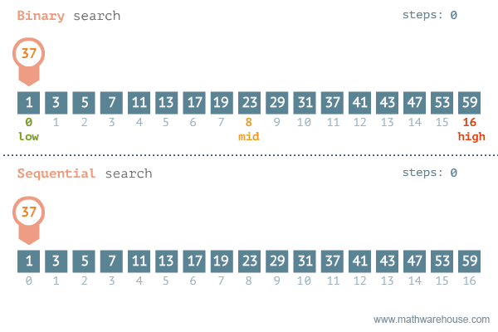
Searching Techniques in Data Structure Linear VS Binary Search
For further assistance, code and slide https://fahadhussaincs.blogspot.com/
YouTube Channel : https://www.youtube.com/fahadhussaintutorial

Slide 83
Thank You!
For further assistance, code and slide https://fahadhussaincs.blogspot.com/
YouTube Channel : https://www.youtube.com/fahadhussaintutorial

Slide 84
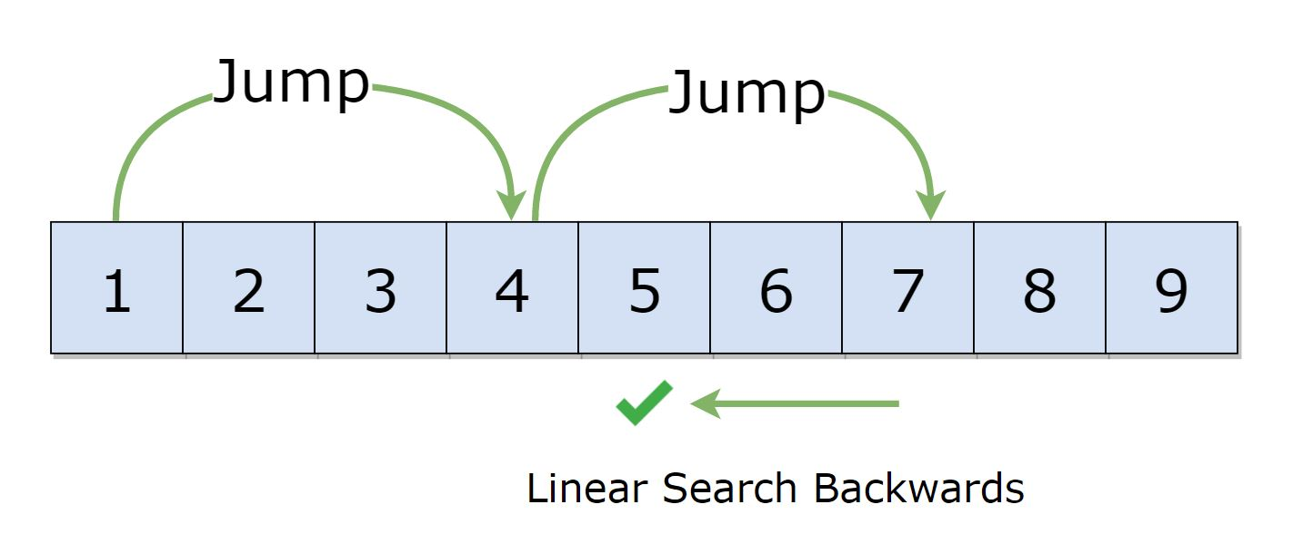
Searching Techniques in Data Structure (Jump Search)
The fundamental idea behind this searching technique is to search fewer number of elements compared to linear search algorithm (which scans every element in the array to check if it matches with the element being searched or not). This can be done by skipping some fixed number of array elements or jumping ahead by fixed number of steps in every iteration.
For further assistance, code and slide https://fahadhussaincs.blogspot.com/
YouTube Channel : https://www.youtube.com/fahadhussaintutorial

Slide 85
Searching Techniques in Data Structure (Jump Search)
Step 1: Set i=0 and m = √n.
Step 2: Compare A[i] with item. If A[i] != item and A[i] < item, then jump to the next block. Also, do the following:
Set i = m
Increment m by √n
Step 3: Repeat the step 2 till m < n-1
Step 4: If A[i] > item, then move to the beginning of the current block and perform a linear search.
Set x = i
Compare A[x] with item. If A[x]== item, then print x as the valid location else set x++
Repeat Step 4.1 and 4.2 till x < m
Step 5: Exit
Sorted array A of size n
Element to be searched, say item
A valid location of item in the array A
Size of jump = m
Total number of comparisons will be (n/m+(m-1)).

Slide 86
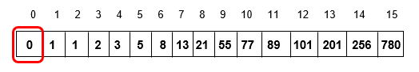
Searching Techniques in Data Structure (Jump Search)

Slide 87
Searching Techniques in Data Structure (Jump Search)
int jump_Search (int a[], int n, int item) {
int i = 0;
int m = sqrt(n); //initializing block size= √(n)
while(a[m] <= item && m < n) {
// the control will continue to jump the blocks
i = m; // shift the block
m += sqrt(n);
if(m > n - 1) // if m exceeds the array size
return -1;
}
for(int x = i; x<m; x++) { //linear search in current block
if(a[x] == item)
return x; //position of element being searched
}
return -1;
}
Time complexity of O(√n).

Slide 88
Thank You!
For further assistance, code and slide https://fahadhussaincs.blogspot.com/
YouTube Channel : https://www.youtube.com/fahadhussaintutorial

Slide 89
Sorting Techniques in Data Structure Important term in Sorting Algorithm
Sorting refers to the operation or technique of arranging and rearranging sets of data in some specific order.(ascending or descending order)
E.g. Phone dictionary, searching…
What is Sorting and why we need it
In-place Sorting and Not-in-place Sorting
Stable and Not Stable Sorting
Adaptive and Non-Adaptive Sorting Algorithm

Slide 90
Sorting Techniques in Data Structure Techniques in Sorting Algorithm
The techniques of sorting can be divided into two categories. These are:
Internal Sorting
External Sorting
Internal Sorting: If all the data that is to be sorted can be adjusted at a time in the main memory, the internal sorting method is being performed.
External Sorting: When the data that is to be sorted cannot be accommodated in the memory at the same time and some has to be kept in auxiliary memory such as hard disk, floppy disk, magnetic tapes etc.., then external sorting methods are performed. (Natural, polyphase, balanced techniques used here)

Slide 91
Different Sorting Algorithms
There are many different techniques available for sorting, differentiated by their
efficiency and space requirements. (space & Time)
Bubble Sort
Insertion Sort
Selection Sort
Quick Sort
Merge Sort
Heap Sort
Shell Sort

Slide 92
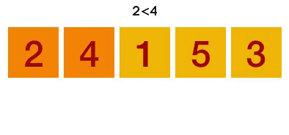
Bubble Sort
Starting with the first element(index = 0), compare the current element with the next element of the array.
If the current element is greater than the next element of the array, swap them.
If the current element is less than the next element, move to the next element. Repeat Step 1.
15, 20, 6, 8, 4 : N=5, I =1 to n-1, j = 1 to n-1

Slide 93
Bubble Sort Code
void bubbleSort (int arr[], int n)
{
int i, j, temp;
for(i = 0; i < n; i++)
{
for(j = 0; j < n-i-1; j++)
{
// introducing a flag to monitor swapping
int flag = 0;
if( arr[j] > arr[j+1])
{
// swap the elements
temp = arr[j];
arr[j] = arr[j+1];
arr[j+1] = temp;
// if swapping happens update flag to 1
flag = 1;
}
}
// if value of flag is zero after all the iterations of inner loop
// then break out
if(!flag)
{
break;
}
}
// print the sorted array
printf("Sorted Array: ");
for(i = 0; i < n; i++)
{
printf("%d ", arr[i]);
}
}
Complexity (n-1)(n-1) = n^2

Slide 94
Thank You!
For further assistance, code and slide https://fahadhussaincs.blogspot.com/
YouTube Channel : https://www.youtube.com/fahadhussaintutorial

Slide 95
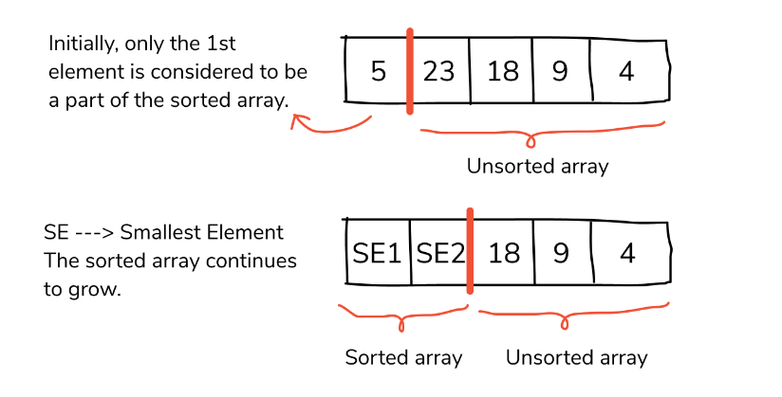
Insertion Sort
Insertion sort is a sorting algorithm in which the elements are transferred one at a time to the right position. In other words, an insertion sort helps in building the final sorted list, one item at a time, with the movement of higher-ranked elements. An insertion sort has the benefits of simplicity and low overhead

Slide 96
Insertion Sort Algorithm
We compare the key element with the element(s) before it, in this case, element at index 0:
If the key element is less than the first element, we insert the key element before the first element.
If the key element is greater than the first element, then we insert it after the first element.
Then, we make the third element of the array as key and will compare it with elements to it's left and insert it at the right position.
And we go on repeating this, until the array is sorted.

Slide 97
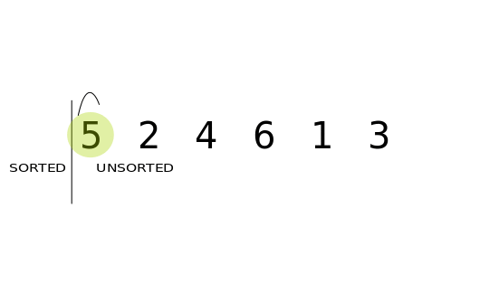
Insertion Sort Example

Slide 98
Insertion Sort
void insertionSort(int arr[], int length)
{
int i, j, key;
for (i = 1; i < length; i++)
{
j = i;
while (j > 0 && arr[j - 1] > arr[j])
{
key = arr[j];
arr[j] = arr[j - 1];
arr[j - 1] = key;
j--;
}
}
print "Sorted Array: ";
// print the sorted array
printArray(arr, length);
} Worst Case Time Complexity [ Big-O ]: O(n²)

Slide 99
Thank You!
For further assistance, code and slide https://fahadhussaincs.blogspot.com/
YouTube Channel : https://www.youtube.com/fahadhussaintutorial

Slide 100
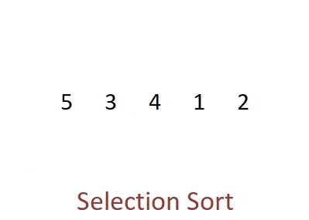
Selection Sort
Selection sort is conceptually the most simplest sorting algorithm. This sorting algorithm is an in-place comparison-based algorithm this algorithm will first find the smallest element in the array and swap it with the element in the first position, then it will find the second smallest element and swap it with the element in the second position, and it will keep on doing this until the entire array is sorted.
It is called selection sort because it repeatedly selects the next-smallest element and swaps it into the right place.

Slide 101
Selection Sort Algorithm
Starting from the first element, we search the smallest element in the array, and replace it with the element in the first position.
We then move on to the second position, and look for smallest element present in the subarray, starting from index 1, till the last index.
We replace the element at the second position in the original array, or we can say at the first position in the subarray, with the second
smallest element.
This is repeated, until the array is completely sorted.

Slide 102
Selection Sort Algorithm
3, 6, 1, 8, 4, 5

Slide 103
Selection Sort Code
procedure selection sort
list : array of items
n : size of list
for i = 1 to n - 1
/* set current element as minimum*/
min = i
/* check the element to be minimum */
for j = i+1 to n
if list[j] < list[min] then
min = j;
end if
end for
/* swap the minimum element with the current element*/
if indexMin != i then
swap list[min] and list[i]
end if
end for
end procedure
Worst Case Time Complexity O(n²)

Slide 104
Thank You!
For further assistance, code and slide https://fahadhussaincs.blogspot.com/
YouTube Channel : https://www.youtube.com/fahadhussaintutorial

Slide 105

Merge Sort Code
Merge sort is a sorting technique based on divide and conquer technique
If we can break a single big problem into smaller sub-problems, solve the smaller sub-problems and combine their solutions to find the solution for the original big problem, it becomes easier to solve the whole problem.

Slide 106
Merge Sort Code
Step 1 − if it is only one element in the list it is already sorted, return.
Step 2 − divide the list recursively into two halves until it can no more be divided.
Step 3 − merge the smaller lists into new list in sorted order.
14, 7, 3, 12, 9, 11, 6, 12
For further assistance, code and slide https://fahadhussaincs.blogspot.com/
YouTube Channel : https://www.youtube.com/fahadhussaintutorial

Slide 107
Merge Sort Pseudocode
procedure mergesort( var a as array )
if ( n == 1 ) return a
var l1 as array = a[0] ... a[n/2]
var l2 as array = a[n/2+1] ... a[n]
l1 = mergesort( l1 )
l2 = mergesort( l2 )
return merge( l1, l2 )
end procedure
procedure merge( var a as array, var b as array )
var c as array
while ( a and b have elements )
if ( a[0] > b[0] )
add b[0] to the end of c
remove b[0] from b
else
add a[0] to the end of c
remove a[0] from a
end if
end while
while ( a has elements )
add a[0] to the end of c
remove a[0] from a
end while
while ( b has elements )
add b[0] to the end of c
remove b[0] from b
end while
return c
end procedure
we divide a number into half in every step, it can be represented using a logarithmic function, which is log n and the number of steps can be represented by log n + 1(at most) Also, we perform a single step operation to find out the middle of any subarray, i.e. O(1).
therefore, n(log n + 1),

Slide 108
Thank You!
For further assistance, code and slide https://fahadhussaincs.blogspot.com/
YouTube Channel : https://www.youtube.com/fahadhussaintutorial

Slide 109

Quick Sort
Quick sort is a highly efficient sorting algorithm and is based on partitioning of array of data into smaller arrays. A large array is partitioned into two arrays one of which holds values smaller than the specified value, say pivot, based on which the partition is made and another array holds values greater than the pivot value.
It is using recursively approach with divided and conquer algorithm.
Pivot element can be any element from the array, it can be the first element, the last element or any random element (point of division).
For further assistance, code and slide https://fahadhussaincs.blogspot.com/
YouTube Channel : https://www.youtube.com/fahadhussaintutorial

Slide 110
Quick Sort Works
After selecting an element as pivot, which is the last index of the array in our case, we divide the array for the first time.
In quick sort, we call this partitioning. It is not simple breaking down of array into 2 subarrays, but in case of partitioning, the array elements are so positioned that all the elements smaller than the pivot will be on the left side of the pivot and all the elements greater than the pivot will be on the right side of it.
And the pivot element will be at its final sorted position.
The elements to the left and right, may not be sorted.
Then we pick subarrays, elements on the left of pivot and elements on the right of pivot, and we perform partitioning on them by choosing a pivot in the subarrays.
For further assistance, code and slide https://fahadhussaincs.blogspot.com/
YouTube Channel : https://www.youtube.com/fahadhussaintutorial

Slide 111
Quick Sort Works
6 3 7 2 4 5
5 3 7 2 4 6
5 3 6 2 4 7
5 3 6 2 4 7
5 3 4 2 6 7
For further assistance, code and slide https://fahadhussaincs.blogspot.com/
YouTube Channel : https://www.youtube.com/fahadhussaintutorial

Slide 112
Quick Sort Code
void swap(int* a, int* b)
{
int t = *a;
*a = *b;
*b = t;
}
/*
a[] is the array, p is starting index, that is 0,
and r is the last index of array.
*/
void quicksort(int a[], int p, int r)
{
if(p < r)
{
int q;
q = partition(a, p, r);
quicksort(a, p, q);
quicksort(a, q+1, r);
}
}
int partition (int a[], int low, int high)
{
int pivot = arr[high]; // selecting last element as pivot
int i = (low - 1); // index of smaller element
for (int j = low; j <= high- 1; j++)
{
// If current element is smaller than or equal to pivot
if (arr[j] <= pivot)
{
i++; // increment index of smaller element
swap(&arr[i], &arr[j]);
}
}
swap(&arr[i + 1], &arr[high]);
return (i + 1);
}
// function to print the array
void printArray(int a[], int size)
{
int i;
for (i=0; i < size; i++)
{
printf("%d ", a[i]);
}
printf("\n");
}

Slide 113
Thank You!
For further assistance, code and slide https://fahadhussaincs.blogspot.com/
YouTube Channel : https://www.youtube.com/fahadhussaintutorial

Slide 114

Heap Sort
Binary Tree:
A tree whose elements have at most 2 children is called a binary tree. Since each element in a binary tree can have only 2 children, we typically name them the left and right child.
For further assistance, code and slide https://fahadhussaincs.blogspot.com/
YouTube Channel : https://www.youtube.com/fahadhussaintutorial

Slide 115

Heap Sort
A Heap is a special Tree-based data structure in which the tree is a complete binary tree,also Heap Sort is one of the best sorting methods being in-place and with no quadratic worst-case running time. Generally, Heaps can be of two types:
Max-Heap: In a Max-Heap the key present at the root node must be greatest among the keys present at all of it’s children. The same property must be recursively true for all sub-trees in that Binary Tree.
Min-Heap: In a Min-Heap the key present at the root node must be minimum among the keys present at all of it’s children. The same property must be recursively true for all sub-trees in that Binary Tree.
Ascending order (Min Heap)
Descending order (Max Heap)

Slide 116
Heap Sort Algorithm
Creating a Heap of the unsorted list/array.
Then a sorted array is created by repeatedly removing the largest/smallest element from the heap, and inserting it into the array. The heap is reconstructed after each removal.
45, 29, 51, 21, 59, 54, 77, 54 (First create a heap of max. for decending order sorting)

Slide 117
Heap Sort Algorithm
void heapify (int arr[], int n, int i)
{
int largest = i;
int l = 2*i + 1;
int r = 2*i + 2;
// if left child is larger than root
if (l < n && arr[l] > arr[largest])
largest = l;
// if right child is larger than largest so far
if (r < n && arr[r] > arr[largest])
largest = r;
// if largest is not root
if (largest != i)
{
swap(arr[i], arr[largest]);
// recursively heapify the affected sub-tree
heapify(arr, n, largest);
}
}
void heapSort(int arr[], int n)
{
// build heap (rearrange array)
for (int i = n / 2 - 1; i >= 0; i--)
heapify(arr, n, i);
// one by one extract an element from heap
for (int i=n-1; i>=0; i--)
{
// move current root to end
swap(arr[0], arr[i]);
// call max heapify on the reduced heap
heapify(arr, i, 0);
}
}
Worst Case Time Complexity: O(n log n)
Best Case Time Complexity: O(n log n)
Average Time Complexity: O(n log n)

Slide 118
Thank You!
For further assistance, code and slide https://fahadhussaincs.blogspot.com/
YouTube Channel : https://www.youtube.com/fahadhussaintutorial

Slide 119
Shell Sort
Shell sort, also known as Shell sort or Shell's method, is an in-place comparison sort. It can be seen as either a generalization of sorting by exchange (bubble sort) or sorting by insertion (insertion sort). The method starts by sorting pairs of elements far apart from each other, then progressively reducing the gap between elements to be compared. Starting with far apart elements, it can move some out-of-place elements into position faster than a simple nearest neighbor exchange..
For further assistance, code and slide https://fahadhussaincs.blogspot.com/
YouTube Channel : https://www.youtube.com/fahadhussaintutorial

Slide 120
Shell Sort Points
Shell Sort is a comparison based sorting.
Time complexity of Shell Sort depends on gap sequence . Its best case time complexity is O(n* logn) and worst case is O(n* log²n). Time complexity of Shell sort is generally assumed to be near to O(n) and less than O(n²) as determining its time complexity is still an open problem.
The best case in shell sort is when the array is already sorted. The number of comparisons is less.
It is an in-place sorting algorithm as it requires no additional scratch space.
Shell Sort is unstable sort as relative order of elements with equal values may change.
For further assistance, code and slide https://fahadhussaincs.blogspot.com/
YouTube Channel : https://www.youtube.com/fahadhussaintutorial

Slide 121
Shell Sort Example
70, 40, 15, 30, 60, 20
Pass 01:
0,3=
1,4=
2,5=

Slide 122
Shell Sort Points
80, 50, 60, 30, 10, 20, 40, 70
Pass 01:
0,4=
1,5=
2,6=
3,7=
Pass 02:
0,2=
1,3=
2,4=
3,5=
3,1=
4,6=
4,2=
2,1=
5,7 =

Slide 123
Shell Sort Points
void shellSort (int array[], int n){
for (int gap = n/2; gap > 0; gap /= 2){
for (int i = gap; i < n; i += 1) {
int temp = array[i];
int j;
for (j = i; j >= gap && array[j - gap] > temp; j -= gap){
array[j] = array[j - gap];
}
array[j] = temp;
}
}
}
Worst case complexity for shell sort is always less than or equal to O(n2).

Slide 124
Thank You!
For further assistance, code and slide https://fahadhussaincs.blogspot.com/
YouTube Channel : https://www.youtube.com/fahadhussaintutorial

Slide 125
Radix Sort
Radix sort is one of the sorting algorithms used to sort a list of integer numbers in order. In radix sort algorithm, a list of integer numbers will be sorted based on the digits of individual numbers. Sorting is performed from least significant digit to the most significant digit.
Radix sort algorithm requires the number of passes which are equal to the number of digits present in the largest number among the list of numbers. For example, if the largest number is a 3 digit number then that list is sorted with 3 passes.
For further assistance, code and slide https://fahadhussaincs.blogspot.com/
YouTube Channel : https://www.youtube.com/fahadhussaintutorial

Slide 126
Radix Sort
Step 1 - Define 10 queues each representing a bucket for each digit from 0 to 9.
Step 2 - Consider the least significant digit of each number in the list which is to be sorted.
Step 3 - Insert each number into their respective queue based on the least significant digit.
Step 4 - Group all the numbers from queue 0 to queue 9 in the order they have inserted into their respective queues.
Step 5 - Repeat from step 3 based on the next least significant digit.
For further assistance, code and slide https://fahadhussaincs.blogspot.com/
YouTube Channel : https://www.youtube.com/fahadhussaintutorial

Slide 127
Radix Sort
89 905 100 13 150 77 56 22
For further assistance, code and slide https://fahadhussaincs.blogspot.com/
YouTube Channel : https://www.youtube.com/fahadhussaintutorial

Slide 128
Radix Sort Algorithm Code
void countsort(int arr[],int n,int place)
{
int i,freq[range]={0}; //range for integers is 10 as digits range from 0-9
int output[n];
for(i=0;i<n;i++)
freq[(arr[i]/place)%range]++;
for(i=1;i<range;i++)
freq[i]+=freq[i-1];
for(i=n-1;i>=0;i--)
{
output[freq[(arr[i]/place)%range]-1]=arr[i];
freq[(arr[i]/place)%range]--;
}
for(i=0;i<n;i++)
arr[i]=output[i];
}
void radixsort(ll arr[],int n,int maxx)
//maxx is the maximum element in the array
{
int mul=1;
while(maxx)
{
countsort(arr,n,mul);
mul*=10;
maxx/=10;
}
}
Complexity: O( d + ( n + b ))
For further assistance, code and slide https://fahadhussaincs.blogspot.com/
YouTube Channel : https://www.youtube.com/fahadhussaintutorial

Slide 129
Thank You!
For further assistance, code and slide https://fahadhussaincs.blogspot.com/
YouTube Channel : https://www.youtube.com/fahadhussaintutorial

Slide 130
Counting Sort
Counting sort is a sorting algorithm that sorts the elements of an array by counting the number of occurrences of each unique element in the array. The count is stored in an auxiliary array and the sorting is done by mapping the count as an index of the auxiliary array. (array to be used to count the occurrence of data)
For further assistance, code and slide https://fahadhussaincs.blogspot.com/
YouTube Channel : https://www.youtube.com/fahadhussaintutorial

Slide 131
Counting Sort Algorithm
Find out the maximum element (let it be max) from the given array.
Initialize an array of length max+1 with all elements 0. This array is used for storing the count of the elements in the array.
Store the count of each element at their respective index in count array
Store cumulative sum of the elements of the count array
Find the index of each element of the original array in count array. This gives the cumulative count. Place the element at the index calculated
After placing each element at its correct position, decrease the its count by one.
For further assistance, code and slide https://fahadhussaincs.blogspot.com/
YouTube Channel : https://www.youtube.com/fahadhussaintutorial

Slide 132
Counting Sort Algorithm
Range( 1 to 7)
1, 3, 5, 4, 1, 6, 2, 7, 2, 5, 6
O(n + k)
For further assistance, code and slide https://fahadhussaincs.blogspot.com/
YouTube Channel : https://www.youtube.com/fahadhussaintutorial

Slide 133
Counting Sort Algorithm (Pseudocode)
countingSort (array, size)
max <= find largest element in array
initialize count array with all zeros
for j <= 0 to size
find the total count of each unique element and
store the count at jth index in count array
for i <= 1 to max
find the cumulative sum and store it in count array itself
for j <= size down to 1
restore the elements to array
decrease count of each element restored by 1
For further assistance, code and slide https://fahadhussaincs.blogspot.com/
YouTube Channel : https://www.youtube.com/fahadhussaintutorial

Slide 134
Thank You!
For further assistance, code and slide https://fahadhussaincs.blogspot.com/
YouTube Channel : https://www.youtube.com/fahadhussaintutorial

Slide 135

Sort Algorithm, Comparison Analysis
Comparison Based Soring techniques are bubble sort, selection sort, insertion sort, Merge sort, quicksort, heap sort etc. These techniques are considered as comparison based sort because in these techniques the values are compared, and placed into sorted position in different phases. Here we will see time complexity of these techniques.

Slide 136

Sort Algorithm, Comparison Analysis
Some sorting algorithms are non-comparison based algorithm. Some of them are Radix sort, Bucket sort, count sort. These are non-comparison based sort because here two elements are not compared while sorting. The techniques are slightly different. Now we will see the difference between them based on different type of analysis.

Slide 137
Sort Algorithm, Comparison Analysis
Useful Link
https://latesthackingnews.com/2016/12/10/comparison-various-sorting-algorithms/
https://www.geeksforgeeks.org/analysis-of-different-sorting-techniques/

Slide 138
Thank You!
For further assistance, code and slide https://fahadhussaincs.blogspot.com/
YouTube Channel : https://www.youtube.com/fahadhussaintutorial

Slide 139
Data Structure (Tree)
For further assistance, code and slide https://fahadhussaincs.blogspot.com/
YouTube Channel : https://www.youtube.com/fahadhussaintutorial

Slide 140


Tree Data Structure (Non Linear)
Tree is a hierarchical data structure which stores the information naturally in the form of hierarchy style. Tree is one of the most powerful and advanced data structures. It is a non-linear data structure compared to arrays, linked lists, stack and queue. It represents the nodes connected by edges.

Slide 141

Tree Data Structure (Non Linear)
For further assistance, code and slide https://fahadhussaincs.blogspot.com/
YouTube Channel : https://www.youtube.com/fahadhussaintutorial

Slide 142




Tree Data Structure (terminologies )
Degree of a node is the total number of children of that node.
Degree of a tree is the highest degree of a node among all the nodes in the tree.
In a tree, each step from top to bottom is called as level of a tree.
The level count starts with 0 and increments by 1 at each level or step
Total number of edges from root node to a particular node is called as depth of that node.
Depth of a tree is the total number of edges from root node to a leaf node in the longest path, Depth of the root node = 0, The terms “level” and “depth” are used interchangeably.
A forest is a set of disjoint trees.

Slide 143

Tree Data Structure (Non Linear)
Tree in C language:
struct node
{
int data;
struct node *left;
struct node *right;
};

Slide 144
Tree Data Structure (Non Linear) Advantages
Tree reflects structural relationships in the data.
It is used to represent hierarchies.
It provides an efficient insertion and searching operations.
Trees are flexible. It allows to move subtrees around with minimum effort.
For further assistance, code and slide https://fahadhussaincs.blogspot.com/
YouTube Channel : https://www.youtube.com/fahadhussaintutorial

Slide 145
Thank You!
For further assistance, code and slide https://fahadhussaincs.blogspot.com/
YouTube Channel : https://www.youtube.com/fahadhussaintutorial

Slide 146

Tree Data Structure (Binary Tree)
Binary tree is a special tree data structure in which each node can have at most 2 children.
Thus, in a binary tree, Each node has either 0 child or 1 child or 2 children.
For further assistance, code and slide https://fahadhussaincs.blogspot.com/
YouTube Channel : https://www.youtube.com/fahadhussaintutorial

Slide 147

Tree Data Structure (Binary Tree)
Unlabeled Binary Tree
For further assistance, code and slide https://fahadhussaincs.blogspot.com/
YouTube Channel : https://www.youtube.com/fahadhussaintutorial

Slide 148

Tree Data Structure (Binary Tree)
Labeled Binary Tree
For further assistance, code and slide https://fahadhussaincs.blogspot.com/
YouTube Channel : https://www.youtube.com/fahadhussaintutorial

Slide 149

Types of Binary Tree
For further assistance, code and slide https://fahadhussaincs.blogspot.com/
YouTube Channel : https://www.youtube.com/fahadhussaintutorial

Slide 150

Types of Binary Tree
A rooted binary tree is a binary tree that satisfies the following 2 properties-
It has a root node.
Each node has at most 2 children.
For further assistance, code and slide https://fahadhussaincs.blogspot.com/
YouTube Channel : https://www.youtube.com/fahadhussaintutorial

Slide 151

Types of Binary Tree
A binary tree in which every node has either 0 or 2 children is called as a Full binary tree.
Full binary tree is also called as Strictly binary tree.
For further assistance, code and slide https://fahadhussaincs.blogspot.com/
YouTube Channel : https://www.youtube.com/fahadhussaintutorial

Slide 152

Types of Binary Tree
A complete binary tree is a binary tree that satisfies the following 2 properties-
Every internal node has exactly 2 children.
All the leaf nodes are at the same level.
Complete binary tree is also called as Perfect binary tree.
For further assistance, code and slide https://fahadhussaincs.blogspot.com/
YouTube Channel : https://www.youtube.com/fahadhussaintutorial

Slide 153

Types of Binary Tree
An almost complete binary tree is a binary tree that satisfies the following 2 properties:
All the levels are completely filled except possibly the last level.
The last level must be strictly filled from left to right.
For further assistance, code and slide https://fahadhussaincs.blogspot.com/
YouTube Channel : https://www.youtube.com/fahadhussaintutorial

Slide 154

Types of Binary Tree
A skewed binary tree is a binary tree that satisfies the following 2 properties-
All the nodes except one node has one and only one child.
The remaining node has no child. OR
A skewed binary tree is a binary tree of n nodes such that its depth is (n-1)
For further assistance, code and slide https://fahadhussaincs.blogspot.com/
YouTube Channel : https://www.youtube.com/fahadhussaintutorial

Slide 155
Thank You!
For further assistance, code and slide https://fahadhussaincs.blogspot.com/
YouTube Channel : https://www.youtube.com/fahadhussaintutorial

Slide 156

Binary Tree Traversal
Tree Traversal refers to the process of visiting each node in a tree data structure exactly once.
Preorder Traversal
Inorder Traversal
Postorder Traversal
For further assistance, code and slide https://fahadhussaincs.blogspot.com/
YouTube Channel : https://www.youtube.com/fahadhussaintutorial

Slide 157


Binary Tree Traversal (Preorder Traversal)
Visit the root
Traverse the left sub tree i.e. call Preorder (left sub tree)
Traverse the right sub tree i.e. call Preorder (right sub tree)
Root → Left → Right
Preorder traversal is used to get prefix expression of an expression tree.
Preorder traversal is used to create a copy of the tree.

Slide 158


Binary Tree Traversal (Inorder Traversal)
Traverse the left sub tree i.e. call Inorder (left sub tree)
Visit the root
Traverse the right sub tree i.e. call Inorder (right sub tree)
Left → Root → Right
Inorder traversal is used to get infix expression of an expression tree.

Slide 159


Binary Tree Traversal (Postorder Traversal)
Traverse the left sub tree i.e. call Postorder (left sub tree)
Traverse the right sub tree i.e. call Postorder (right sub tree)
Visit the root
Left → Right → Root
Postorder traversal is used to get postfix expression of an expression tree.
Postorder traversal is used to delete the tree.
This is because it deletes the children first and then it deletes the parent.

Slide 160
Binary Tree Traversal (Postorder Traversal)
void pre_order_traversal (struct node* root) {
if(root != NULL) {
printf("%d ",root->data);
pre_order_traversal(root->leftChild);
pre_order_traversal(root->rightChild);
}
}
void inorder_traversal (struct node* root) {
if(root != NULL) {
inorder_traversal(root->leftChild);
printf("%d ",root->data);
inorder_traversal(root->rightChild);
}
}
Tree in C language:
struct node
{
int data;
struct node *left;
struct node *right;
};
void post_order_traversal (struct node* root) {
if(root != NULL) {
post_order_traversal(root->leftChild);
post_order_traversal(root->rightChild);
printf("%d ", root->data);
}
For further assistance, code and slide https://fahadhussaincs.blogspot.com/
YouTube Channel : https://www.youtube.com/fahadhussaintutorial

Slide 161

2- Breadth First Traversal
Breadth First Traversal of a tree prints all the nodes of a tree level by level.
Breadth First Traversal is also called as Level Order Traversal.
Level order traversal is used to print the data in the same order as stored in the array representation of a complete binary tree.
For further assistance, code and slide https://fahadhussaincs.blogspot.com/
YouTube Channel : https://www.youtube.com/fahadhussaintutorial

Slide 162
Thank You!
For further assistance, code and slide https://fahadhussaincs.blogspot.com/
YouTube Channel : https://www.youtube.com/fahadhussaintutorial

Slide 163

Binary Search Tree Operations
Binary search tree (BST) is a special kind of binary tree where each node contains
Only larger values in its right subtree.
Only smaller values in its left subtree.
struct node
{
int data; //node will store an integer
struct node *right_child; // right child
struct node *left_child; // left child
};
For further assistance, code and slide https://fahadhussaincs.blogspot.com/
YouTube Channel : https://www.youtube.com/fahadhussaintutorial

Slide 164

Binary Search Tree Operations
Sorting ,Search, Insert and Delete in Binary Search Tree
16, 5, 7, 20, 3, 11, 4, 18, 48, 56, 36
For further assistance, code and slide https://fahadhussaincs.blogspot.com/
YouTube Channel : https://www.youtube.com/fahadhussaintutorial

Slide 165

Binary Search Tree Operations
Delete in Binary Search Tree
For Child 0
For Child 1
For Child 2
Replace the delete node with (inorder predecessor)
Replace the delete node with (Inorder successor)
16, 5, 7, 20, 3, 11, 4, 18, 48, 56, 36
For further assistance, code and slide https://fahadhussaincs.blogspot.com/
YouTube Channel : https://www.youtube.com/fahadhussaintutorial

Slide 166
Binary Search Tree Operations
The time complexity of binary search is
Best Case- O( 1 ) i.e. constant
Average Case- O( log n)
Worst Case- O( log n)
For further assistance, code and slide https://fahadhussaincs.blogspot.com/
YouTube Channel : https://www.youtube.com/fahadhussaintutorial

Slide 167
Binary Search Tree Algo.
struct node* search(struct node *root, int x)
{
if(root==NULL || root->data==x) //if root->data is x then the element is found
return root;
else if(x>root->data) // x is greater, so we will search the right subtree
return search(root->right_child, x);
else //x is smaller than the data, so we will search the left subtree
return search(root->left_child,x);
}
//function to find the minimum value in a node
struct node* find_minimum(struct node *root)
{
if(root == NULL)
return NULL;
else if(root->left_child != NULL) // node with minimum value will have no left child
return find_minimum(root->left_child); // left most element will be minimum
return root;
}
//function to create a node
struct node* new_node(int x)
{
struct node *p;
p = malloc(sizeof(struct node));
p->data = x;
p->left_child = NULL;
p->right_child = NULL;
return p;
}
struct node* insert(struct node *root, int x)
{
//searching for the place to insert
if(root==NULL)
return new_node(x);
else if(x>root->data) // x is greater. Should be inserted to right
root->right_child = insert(root->right_child, x);
else // x is smaller should be inserted to left
root->left_child = insert(root->left_child,x);
return root;
}

Slide 168
// funnction to delete a node
struct node* delete(struct node *root, int x)
{
//searching for the item to be deleted
if(root==NULL)
return NULL;
if (x>root->data)
root->right_child = delete(root->right_child, x);
else if(x<root->data)
root->left_child = delete(root->left_child, x);
else
{
//No Children
if(root->left_child==NULL && root->right_child==NULL)
{
free(root);
return NULL;
}
//One Child
else if(root->left_child==NULL || root->right_child==NULL)
{
struct node *temp;
if(root->left_child==NULL)
temp = root->right_child;
else
temp = root->left_child;
free(root);
return temp;
}
//Two Children
else
{
struct node *temp = find_minimum(root->right_child);
root->data = temp->data;
root->right_child = delete(root->right_child, temp->data);
}
}
return root;
}
void inorder(struct node *root)
{
if(root!=NULL) // checking if the root is not null
{
inorder(root->left_child); // visiting left child
printf(" %d ", root->data); // printing data at root
inorder(root->right_child);// visiting right child
}
}

Slide 169
Thank You!
For further assistance, code and slide https://fahadhussaincs.blogspot.com/
YouTube Channel : https://www.youtube.com/fahadhussaintutorial

Slide 170
AVL Tree Rotation
AVL trees are special kind of binary search trees.
In AVL trees, height of left subtree and right subtree of every node differs by at most one.
Height of sub left tree - Height of sub right tree (-1,0,1)
AVL trees are also called as Self-balancing binary search trees.
There are 4 kinds of rotations possible
in AVL Trees (in case of imbalance)
--AVL Tree basic Code to create
Struct AVLNode
{
int data;
struct AVLNode *left, *right;
int balfactor;
};
Right Rotation (RR Rotation)
Left-Right Rotation (LR Rotation)
Right-Left Rotation (RL Rotation) possible in AVL Trees

Slide 171

AVL Tree Cases
3 2 1
Case-03: LR
3 1 2
Case-01 (LL):
1 2 3
Case-02: (RR)
Case-04: RL
For further assistance, code and slide https://fahadhussaincs.blogspot.com/
YouTube Channel : https://www.youtube.com/fahadhussaintutorial

Slide 172
Thank You!
For further assistance, code and slide https://fahadhussaincs.blogspot.com/
YouTube Channel : https://www.youtube.com/fahadhussaintutorial

Slide 173
AVL Tree Operations
Create/Insert a node in AVL Tree
63, 9, 19, 27, 18, 108, 99, 81
For further assistance, code and slide https://fahadhussaincs.blogspot.com/
YouTube Channel : https://www.youtube.com/fahadhussaintutorial

Slide 174
AVL Tree Operations
Delete a node in AVL Tree [ 18, 9, 19]
For further assistance, code and slide https://fahadhussaincs.blogspot.com/
YouTube Channel : https://www.youtube.com/fahadhussaintutorial

Slide 175
Thank You!
For further assistance, code and slide https://fahadhussaincs.blogspot.com/
YouTube Channel : https://www.youtube.com/fahadhussaintutorial

Slide 176
Red Black Tree
A Red Black Tree is a type of self-balancing binary search tree, in which every node is colored with a red or black. The red black tree satisfies all the properties of the binary search tree but there are some additional properties which were added in a Red Black Tree.
The height of a Red-Black tree is O(Log n) where (n is the number of nodes in the tree).
Properties of Red Black Tree
The red - black tree must be a binary search tree.
The root node must be colored black.
Red colored children should have black hair. (There should not be two consecutive red nodes).
All paths in the tree should have nodes of the same type of black color.
Every new node should be highlighted with red color.
The color of each leaf (e.g. NULL node) must be black.
For further assistance, code and slide https://fahadhussaincs.blogspot.com/
YouTube Channel : https://www.youtube.com/fahadhussaintutorial

Slide 177

Red Black Tree
struct t_red_black_node
{
enum { red, black } colour;
void *item;
struct t_red_black_node *left,
*right,
*parent;
}
For further assistance, code and slide https://fahadhussaincs.blogspot.com/
YouTube Channel : https://www.youtube.com/fahadhussaintutorial

Slide 178
Thank You!
For further assistance, code and slide https://fahadhussaincs.blogspot.com/
YouTube Channel : https://www.youtube.com/fahadhussaintutorial

Slide 179
Red Black Tree Operations
Create/Insert a node in Red Black Tree
8, 18, 5, 15, 17, 25, 40, 80
For further assistance, code and slide https://fahadhussaincs.blogspot.com/
YouTube Channel : https://www.youtube.com/fahadhussaintutorial

Slide 180
Red Black Tree Operations
Delete a node in Red Black Tree
For further assistance, code and slide https://fahadhussaincs.blogspot.com/
YouTube Channel : https://www.youtube.com/fahadhussaintutorial

Slide 181
Thank You!
For further assistance, code and slide https://fahadhussaincs.blogspot.com/
YouTube Channel : https://www.youtube.com/fahadhussaintutorial

Slide 182

B-Tree
In search trees like binary search tree, AVL Tree, Red-Black tree, etc., every node contains only one value (key) and a maximum of two children. But there is a special type of search tree called B-Tree in which a node contains more than one value (key) and more than two children. B-Tree was developed in the year 1972 by Bayer and McCreight with the name Height Balanced m-way Search Tree. Later it was named as B-Tree.
1 - All leaf nodes must be at same level.
2 - All nodes except root must have at least [m/2]-1 keys and maximum of m-1 keys.
3 - All non leaf nodes except root (i.e. all internal nodes) must have at least m/2 children.
4 - If the root node is a non leaf node, then it must have at least 2 children.
5 - A non leaf node with n-1 keys must have n number of children.
6 - All the key values in a node must be in Ascending Order.
For further assistance, code and slide https://fahadhussaincs.blogspot.com/
YouTube Channel : https://www.youtube.com/fahadhussaintutorial

Slide 183
B-Tree Insert/Create Operations
12, 14, 16, 18, 20, 10, 22, 8, 2, 23, 50, 3, 17
For further assistance, code and slide https://fahadhussaincs.blogspot.com/
YouTube Channel : https://www.youtube.com/fahadhussaintutorial

Slide 184
Thank You!
For further assistance, code and slide https://fahadhussaincs.blogspot.com/
YouTube Channel : https://www.youtube.com/fahadhussaintutorial

Slide 185
B-Tree Delete Operations and Search
12, 14, 16, 18, 20, 10, 22, 8, 2, 23, 50, 3, 17
Delete 2, 22, 16, 12 and 8
For further assistance, code and slide https://fahadhussaincs.blogspot.com/
YouTube Channel : https://www.youtube.com/fahadhussaintutorial

Slide 186
Thank You!
For further assistance, code and slide https://fahadhussaincs.blogspot.com/
YouTube Channel : https://www.youtube.com/fahadhussaintutorial

Slide 187
Tree Data Structure (Non Linear) Advantages
Link:
https://www.gatevidyalay.com/binary-search-tree-insertion-bst-deletion/
http://jcsites.juniata.edu/faculty/kruse/cs240/bintree.htm

